Slide 1

IDS IMPLEMENTATION, LIMITATIONS AND SIX-STEPS
GROUP 1
ALVARO | BALLESTEROS | CAYABAN | CONAG | ENGINCO | GALLITO | GUARIN | MACATIAG

Slide 2
Table of contents
01
Implementation
02
Hypothesis
03
Objectives

Slide 3
01
Implementation

Slide 4
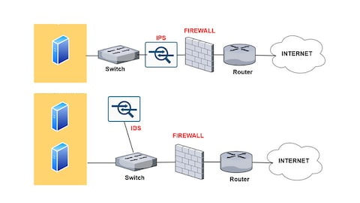
What is an Intrusion Detection System (IDS)?
A system called an intrusion detection system (IDS) observes network traffic for malicious transactions and sends immediate alerts when it is observed. It is software that checks a network or system for malicious activities or policy violations.

Slide 5
What is an Intrusion Detection System (IDS)?
Each illegal activity or violation is often recorded either centrally using a SIEM system or notified to an administration. IDS monitors a network or system for malicious activity and protects a computer network from unauthorized access from users, including perhaps insiders.

Slide 6
What is an Intrusion Detection System (IDS)?
The intrusion detector learning task is to build a predictive model (i.e. a classifier) capable of distinguishing between ‘bad connections’ (intrusion/attacks) and ‘good (normal) connections’.

Slide 7
How does an IDS work?
An IDS (Intrusion Detection System) monitors the traffic on a computer network to detect any suspicious activity.
It analyzes the data flowing through the network to look for patterns and signs of abnormal behavior.
The IDS compares the network activity to a set of predefined rules and patterns to identify any activity that might indicate an attack or intrusion.

Slide 8
How does an IDS work?
If the IDS detects something that matches one of these rules or patterns, it sends an alert to the system administrator.
The system administrator can then investigate the alert and take action to prevent any damage or further intrusion.

Slide 9
Classification of Intrusion Detection System
IDS are classified into 5 types:
Network Intrusion Detection System (NIDS): Network intrusion detection systems (NIDS) are set up at a planned point within the network to examine traffic from all devices on the network. It performs an observation of passing traffic on the entire subnet and matches the traffic that is passed on the subnets to the collection of known attacks.

Slide 10
Classification of Intrusion Detection System
Once an attack is identified or abnormal behavior is observed, the alert can be sent to the administrator. An example of a NIDS is installing it on the subnet where firewalls are located in order to see if someone is trying to crack the firewall.

Slide 11
Classification of Intrusion Detection System
Host Intrusion Detection System (HIDS): Host intrusion detection systems (HIDS) run on independent hosts or devices on the network. A HIDS monitors the incoming and outgoing packets from the device only and will alert the administrator if suspicious or malicious activity is detected. It takes a snapshot of existing system files and compares it with the previous snapshot.

Slide 12
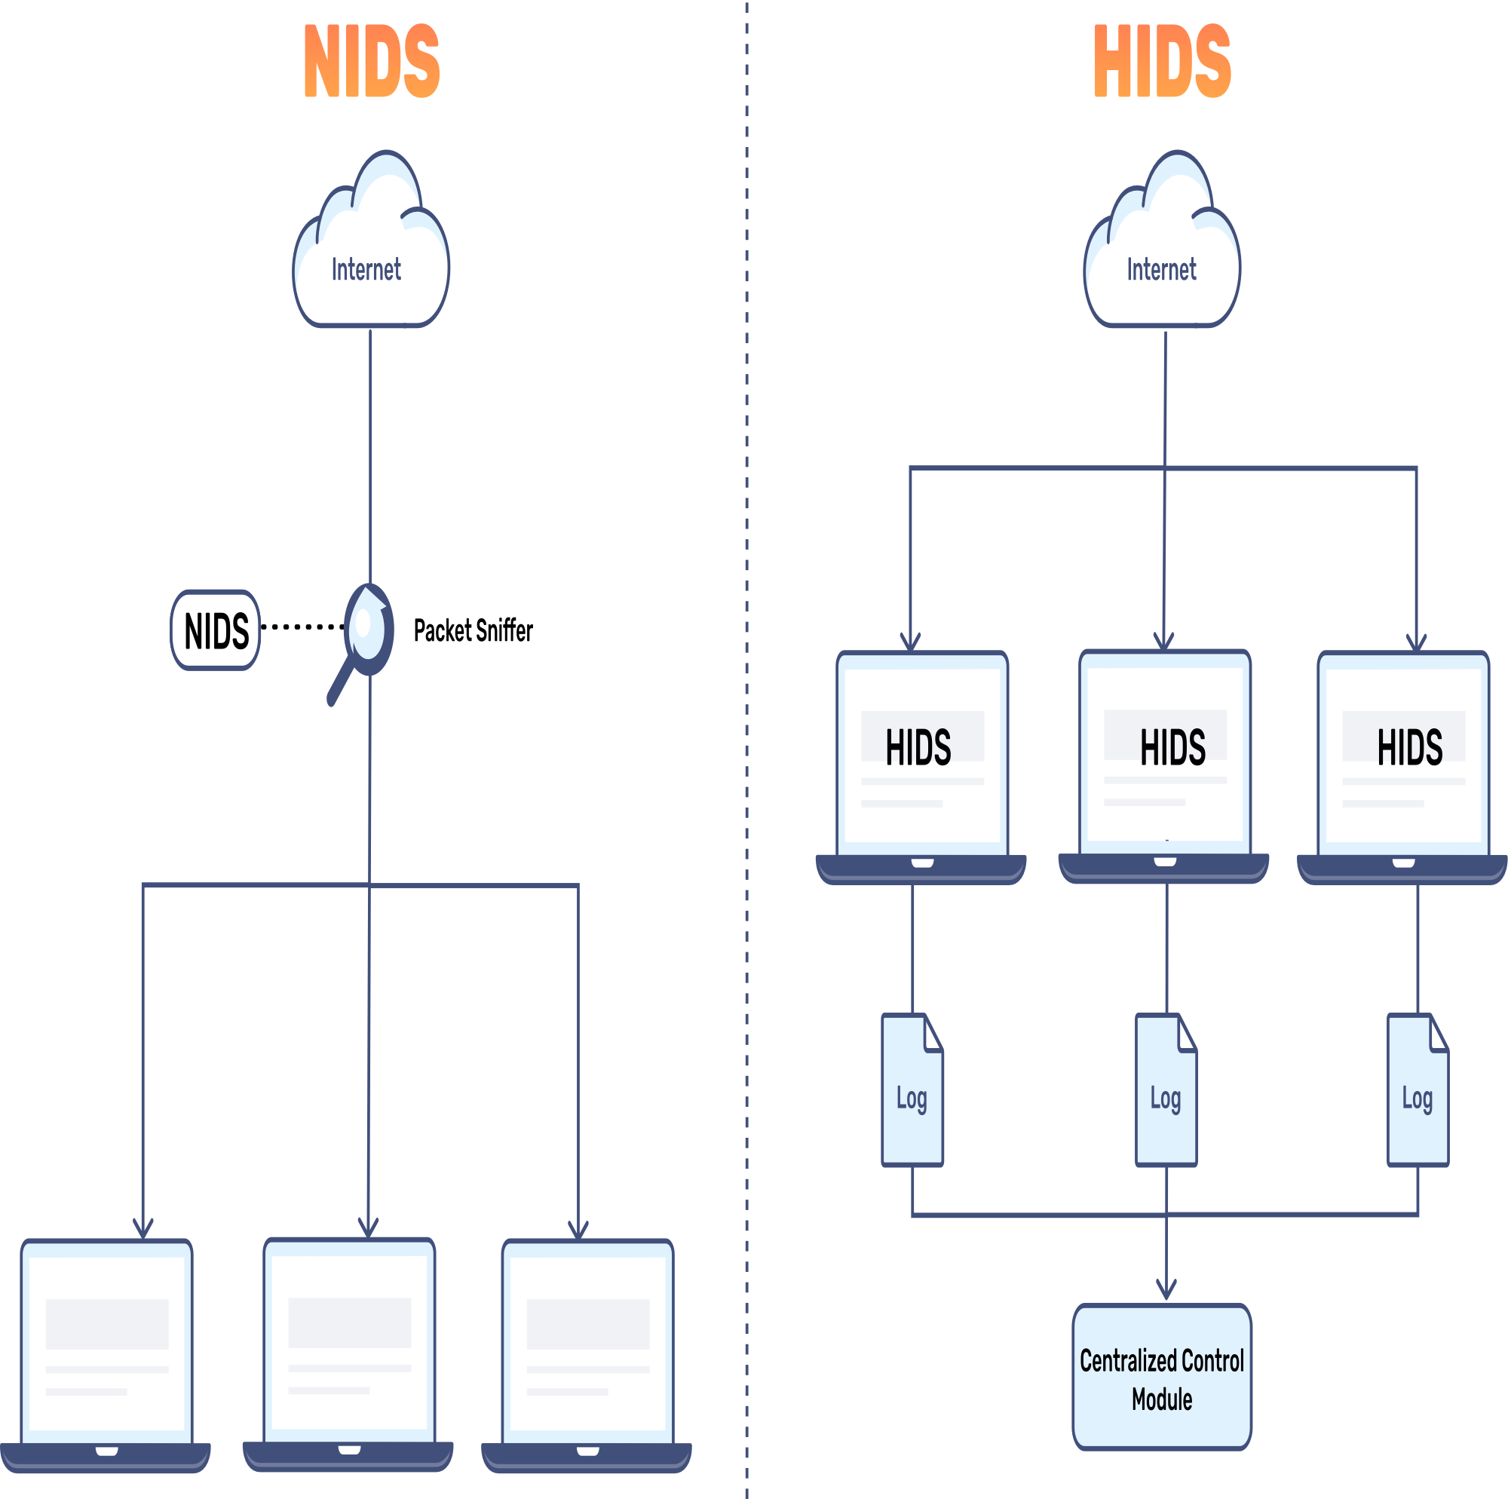

Slide 13
Classification of Intrusion Detection System
If the analytical system files were edited or deleted, an alert is sent to the administrator to investigate. An example of HIDS usage can be seen on mission-critical machines, which are not expected to change their layout.

Slide 14
Classification of Intrusion Detection System
Protocol-based Intrusion Detection System (PIDS): Protocol-based intrusion detection system (PIDS) comprises a system or agent that would consistently reside at the front end of a server, controlling and interpreting the protocol between a user/device and the server. It is trying to secure the web server by regularly monitoring the HTTPS protocol stream and accepting the related HTTP protocol.

Slide 15
Classification of Intrusion Detection System
As HTTPS is unencrypted and before instantly entering its web presentation layer then this system would need to reside in this interface, between to use the HTTPS.

Slide 16
Classification of Intrusion Detection System
As HTTPS is unencrypted and before instantly entering its web presentation layer then this system would need to reside in this interface, between to use the HTTPS.

Slide 17
02
IDS Limitation

Slide 18
IDS Limitation
IDSs have many limitations. These are the major ones:
They aren’t scalable to large or distributed enterprise networks.
They can be difficult to manage, with awkward user control and alarm display interfaces.
Different commercial IDSs rarely interoperate with each other, so you may not be able to consolidate your IDSs across your enterprise if you use more than one vendor’s IDS.

Slide 19
IDS Limitation
Commercial IDSs rarely interoperate with other security or network management packages.
There are significant error rates, especially false positives, in IDS results. These can take up a great deal of a security staff’s time and resource.
They cannot compensate for significant deficiencies in your organizations security strategy, policy, or security architecture.

Slide 20
IDS Limitation
They cannot compensate for security weaknesses in network protocols.
They cannot substitute for other types of security mechanisms (such as Identification and Authentication, encryption, single sign on, firewalls, or access control)
They cannot, by themselves, completely protect a system from all security threats.

Slide 21
03
Six-Steps

Slide 22
Step 1: Validate (Identification)
Security alerts need to be validated — especially if they come from a passive sensor like a network IDS. False positives (false alarms) are a common occurrence and should be distinguished from actual threats. Our customers will generally review the available data provided by the detection tool and/or perform a deep dive on the host.

Slide 23
Ask the following questions:
Is this an actual attack?
Was the attack attempt successful?
What happened on the endpoint/server that was attacked?
What is the severity of the malware or alerted activity? (Most general intel and products are poor at this as what is important for one company may not be important to another.)
With the answers to these four questions, your security team can proceed to step 2, Triage and Identification.

Slide 24
Step 2: Triage (Identification)
If a part of the attack is successfully executed, then determining the scope of the incident is important as lateral movement is a common first step for attackers. You have to ask: Is this the only system affected? You’ll need a quick way to find your answer and, again, Datto can come to the rescue with a quick forensic triage on systems within the same subnet. Gather any ephemeral evidence such as logs at this time as well (some logs roll over quickly) if you plan to investigate more later.

Slide 25
Step 3: Containment
Once validated and scoped, you’ll want to stem the bleeding and remove attacker access. If your triage process does not include Datto, you may want to start this earlier as step 2 for the first system you found. Most antivirus products will have a malware quarantine capability but this generally only works on defined malware and may not quarantine every stage in the attack (modern trojans are multi-staged and may be able to recover from a stage being mitigated or caught).
The important thing is to contain the infected hosts and, if possible, block access to any attacker network addresses on your gateway if applicable.

Slide 26
Step 4: Recovery
You want to get back to business as soon as possible. If one employee was affected, get them back working. If the entire network or domain controller got owned, you’ll probably need to rebuild the domain. Most organizations still implement wipe and reload procedures because software remediation is not foolproof.

Slide 27
Step 5: Investigation (Optional)
Investigations determine the root cause and identify additional details if anything was stolen or affected. Unfortunately, investigations are expensive, time-consuming, and often require a very high level of skills. Nevertheless, you should inspect systems and gather various log sources to create a complete timeline of the attack. If you’re a small team with limited resources, carefully consider if this is an attack you need to investigate. In any case, you should finish your recovery as soon as possible and move on — there will be plenty more attacks in the future.

Slide 28
Step 6: Hardening
Cyber security incident response investigations are helpful not just for the rare case that you find the attacker and are able to prosecute. They also provide an opportunity to discover how the attack occurred and harden your network against future security incidents.
Lessons learned from the incident can provide a foundation for developing additional defenses to help ensure better outcomes in the future. For instance, if email was the vector, you can probably justify phishing training for employees or an upgraded email filtering.

Slide 29
THANK YOU FOR LISTENING!
- GROUP 1 -

Slide 30
Resources
Bace, R. and Mell, P. (2001), Intrusion Detection Systems, Special Publication (NIST SP), National Institute of Standards and Technology, Gaithersburg, MD
https://www.datto.com/blog/ir-planning-the-critical-6-steps-of-cyber-security-incident-response
GeeksforGeeks. (2023, December 6). Intrusion Detection System IDS. https://www.geeksforgeeks.org/intrusion-detection-system-ids/
Mondal, A. (2023, October 12). What is Intrusion Detection System (IDS)? Intellipaat. https://intellipaat.com/blog/intrusion-detection-system/#no3
Bace, R. and Mell, P. (2001), Intrusion Detection Systems, Special Publication (NIST SP), National Institute of Standards and Technology, Gaithersburg, MD
Fichtner, E. (2022, March 8). IR Planning: The Critical 6 Steps of Cyber Security Incident Response. Datto. https://www.datto.com/blog/ir-planning-the-critical-6-steps-of-cyber-security-incident-response

